Slide 1

AI Innovations
Kamaleshwaran N
Selvakumar C
Tejkiran A B
Current Trends in AI
Insights on Emerging Technologies and Applications

Slide 2
AI Technology Trends
Today's AI landscape is rapidly evolving, influencing various industries with innovative solutions that enhance efficiency and transform traditional processes.

Slide 3
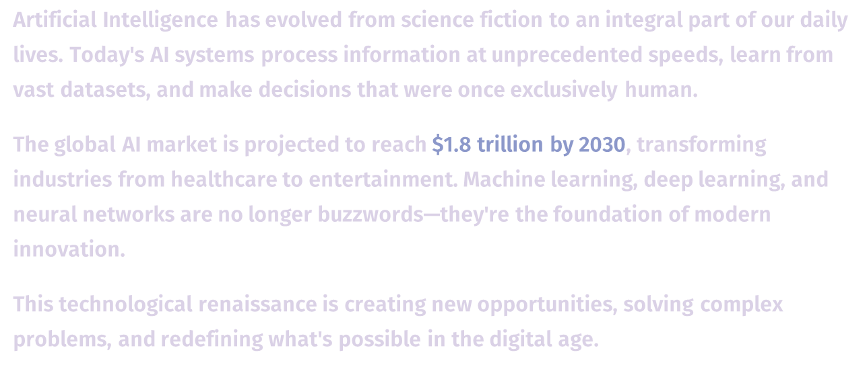
The AI Revolution is Here

Slide 4
Key AI Concepts
AUTOMATION
Automation streamlines processes, reducing human effort and increasing efficiency.
MACHINE LEARNING
Machine learning enables systems to learn from data and improve over time.
NATURAL LANGUAGE PROCESSING
Natural language processing allows machines to understand and interpret human language.

Slide 5
AI Technology Trends
70,000
Companies reporting efficiency
Significantly boosted productivity levels
Recent statistics highlight the impact of AI integration in businesses
190%
Projected market growth
Indicates strong future demand

Slide 6
AI Milestones Timeline
1956
1997
2012
2021
Birth of AI as a field began.
IBM's Deep Blue defeated world champion Garry Kasparov.
AI achieved human-level accuracy in image recognition.
AI technologies transformed diagnostic processes in healthcare.

Slide 7
Exploring AI Technology Benefits
Discover the key advantages of AI systems
Efficiency Gains from AI
Scalability and Insights of AI
Automating repetitive tasks for speed
Reducing human error in processes
Streamlining workflows for productivity
Adapting solutions for growing demands
Analyzing data for informed decisions
Enhancing customer experiences through insights

Slide 8
Emerging AI Concepts
AI Ethics
Ethical considerations are essential for responsible AI development and usage today.
Explainable AI
Ensuring transparency in AI decisions helps users trust and understand AI systems better.
AI in Education
AI is transforming education through personalized learning experiences and intelligent tutoring systems.

Slide 9
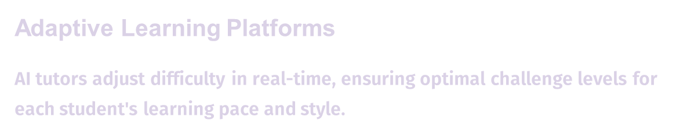
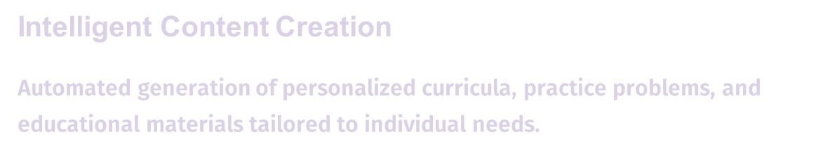


Slide 10
Thank you !!
EMAIL:
2416137@saec.ac.in
PHONE:
1234567890

